Slide 1
Multiple Layer Perceptron (MLP)
CSE301 Bio-computation, Week 5, 2016
Bailing Zhang

Slide 2
Outline
Revision
BP learning with MLP: on-line vs batch
Practical issues in MLP learning
Example of calculation
MLP from Matlab Toolbox

Slide 3
Techniques to overcome overfitting
Weight decay : Decrease each weight by some small factor during each iteration.
The motivation: to keep weight values small.
Add penalty term to the error function
❑ Penalizes large weights to reduce variance
❑ Standard weight decay equation
Matlab implementation
penalises large weights

Slide 4
More on Weight decay
weight decay penalty term causes the weights to converge to smaller absolute values than they otherwise would.
Large weights can hurt generalisation in two different ways.
Excessively large weights leading to hidden units can cause the output function to be too rough, possibly with near discontinuities.
Excessively large weights leading to output units can cause wild outputs far beyond the range of the data if the output activation function is not bounded to the same range as the data.
The main risk with large weights is that the non-linear node outputs could be in one of the flat parts of the transfer function, where the derivative is zero. In such case the learning is irreversibly stopped.

Slide 5
Techniques to overcome overfitting
Cross-validation: a set of validation data in addition to the training data.
The algorithm monitors the error w.r.t. this validation data while using the training set to drive the gradient descent search.
How many weight-tuning iterations should the algorithm perform? It should use the number of iterations that produces the lowest error over the validation set.
Two copies of the weights are kept: one copy for training and a separate copy of the best weights thus far, measured by their error over the validation set.
Once the trained weights reach a higher error over the validation set than the stored weights, training is terminated and the stored weights are returned.

Slide 6
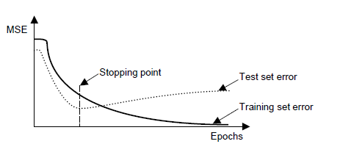
Common types of cross-validation Repeated random sub-sampling validation (Holdout validation)
This method randomly splits the dataset into training and validation data.
For each such split, the model is fit to the training data, and predictive accuracy is assessed using the validation data. The results are then averaged over the splits.
A typical application the holdout method is determining a stopping point for the back propagation error

Slide 7
Holdout validation
The advantage of this method (over k-fold cross validation) is that the proportion of the training/validation split is not dependent on the number of iterations (folds).
The disadvantage of this method is that some observations may never be selected in the validation subsample, whereas others may be selected more than once. In other words, validation subsets may overlap.

Slide 8
Further on Holdout validation
Problems with the validation set approach – small data sets
Not enough data may be available to provide a validation set
Overfitting is most severe for small data sets!
K-fold cross validation may be used
Perform k fold cross validation
Each time determine the number of epochs ep that result in best performance on the respective test partition
Calculate the mean of ep, ep_mean
Final run: train the network on all examples for ep_mean epochs

Slide 9
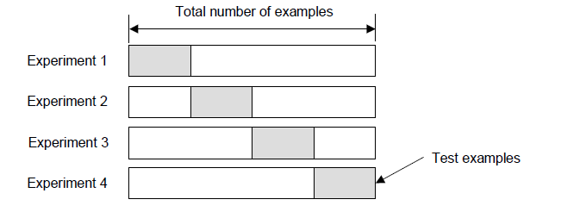
More on k-fold cross-validation
In K-fold cross-validation, the original sample is randomly partitioned into K subsamples. Of the K subsamples, a single subsample is retained as the validation data for testing the model, and the remaining K − 1 subsamples are used as training data.
The cross-validation process is then repeated K times (thefolds), with each of the K subsamples used exactly once as the validation data.

Slide 10
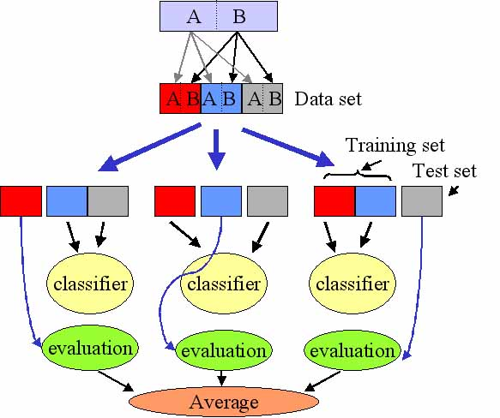

The K results from the folds then can be averaged to produce
a single estimation.
The advantage of this method over repeated random sub-sampling is that all observations are used for both training and validation, and each observation is used for validation exactly once.
10-fold cross-validation is commonly used
the true error is estimated as
the average error rate

Slide 11
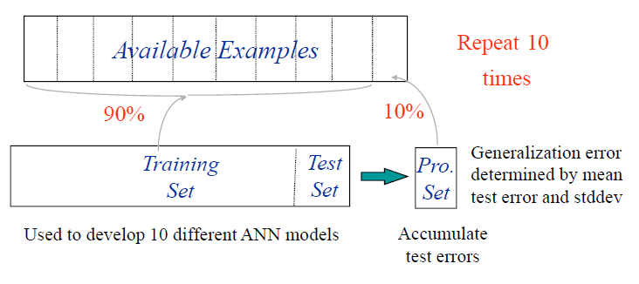
Example 10-fold cross-validation

Slide 12
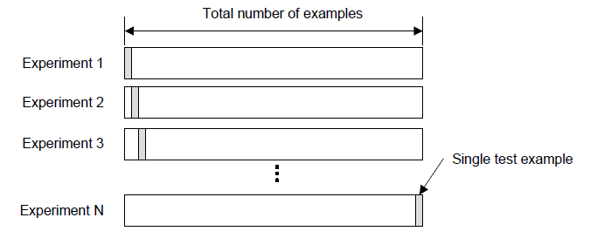
Leave-one-out cross-validation
leave-one-out cross-validation (LOOCV) involves using a single observation from the original sample as the validation data, and the remaining observations as the training data.
This is repeated such that each observation in the sample is used once as the validation data.
This is the same as a K-fold cross-validation with K being equal to the number of observations in the original sample.

Slide 13
Limitations & Capabilities of MLP
MLPs trained with backpropagation can perform function approximation and pattern classification
Theoretically they can
Perform any linear and non-linear mapping
Can approximate any reasonable function arbitrary well
=> are able to overcome the limitations of perceptrons
In practice:
May not always find a solution – can be trapped in a local minimum
The performance is sensitive to the starting conditions (initialization of weights)
Sensitive to the number of hidden layers and neurons
Too few neurons – underfitting, unable to learn what you want it to learn
too many – overfitting, learns slowly
the number of hidden layers and neurons are left to the designer

Slide 14
Limitations & Capabilities of MLP
Sensitive to the value of the learning rate
Too small – slow learning
Too big – instability or poor performance
The proper choices depends on the nature of examples
Trial and error
Refer to the choices that have worked well in similar problems
successful applications of NNs requires time and experience

Slide 15
Backpropagation Summary
uses approximate steepest descent algorithm for minimizing the mean square error
Gradient descent
The standard gradient descent is slow as it requires small learning rate for stable learning
Gradient descent with momentum is faster as it allows higher learning rate while maintaining stability
There are several variations of the backpropagation algorithm.

